Slide 1
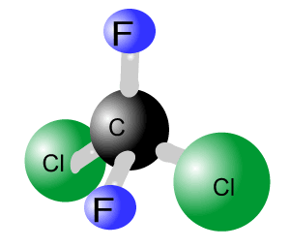
Chlorofluorocarbons (CFCs) and their impact on Environment
Fatima Parveen
(Assist. Professor , Dept. of Chemistry, Govt. P. G. College Rajouri)
Email: - fatimaparveen30@gmail.com

Slide 2
Objectives
CFCs Introduction
Sources
Chemical Reactions
Environmental impacts
CFCs alternatives

Slide 3
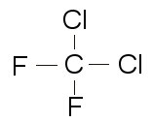
Introduction
CFCs commonly known as Freon
CFCs are Synthetic chemicals
Contain fluorine, chlorine and carbon (no hydrogen)
Have a similar structure to alkanes, with hydrogen replaced by fluorine and chlorine.
E.g. Dichlorodifluoromethane (Freon 12)

Slide 4



Source
CFCs are anthropogenic compounds that are released into the atmosphere, since 1930s because of their wide use in air-conditioning, refrigeration, insulations, propellants (in aerosol applications), and solvents and packing materials.

Slide 5
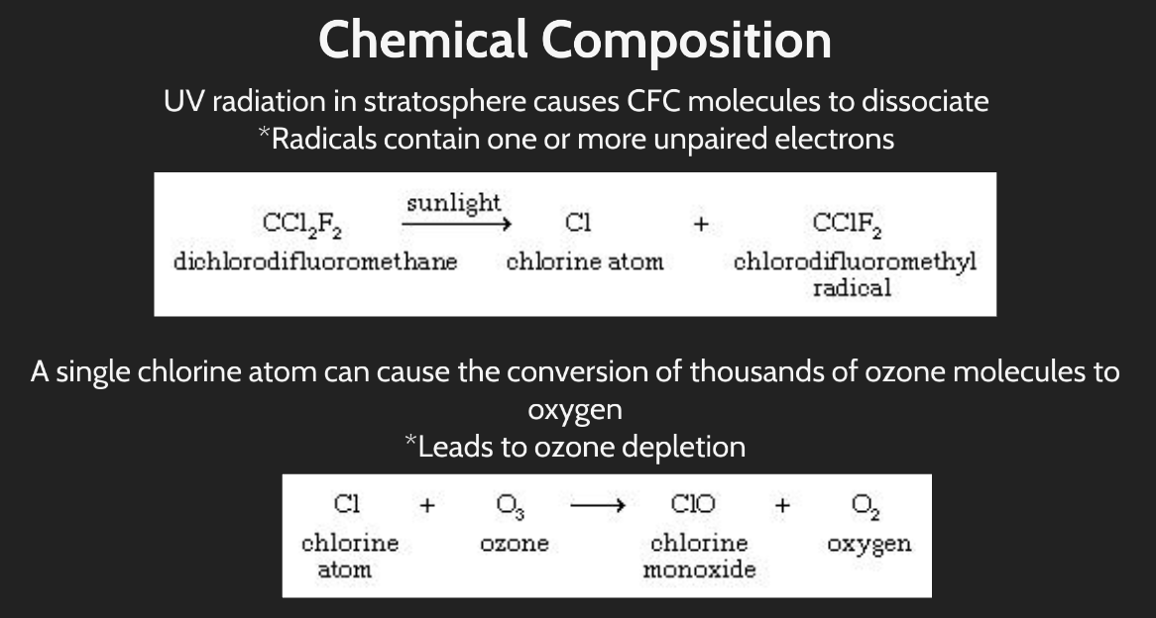
Chemical Reactions

Slide 6
Environmental Impacts
CFCs are greenhouse gases
Absorb heat in the atmosphere, sending some of the absorbed heat back to the surface of the earth
Contribute to global warming and climate change.
UV radiation in stratosphere causes CFC molecules to dissociate into free radicals that contains one or more unpaired electrons.

Slide 7
A single chlorine atom can cause the conversion of thousands of ozone molecules to oxygen that leads to ozone depletion.

Slide 8
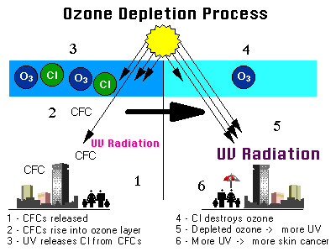
Ozone Depletion
Source: Environmental Protection Agency, USA

Slide 9
Effects of Ozone Depletion
Global Warming
Increase in levels of skin cancer, cataracts, immune system impairment.
Impact on crops and agriculture
Impact on marine food cycle

Slide 10
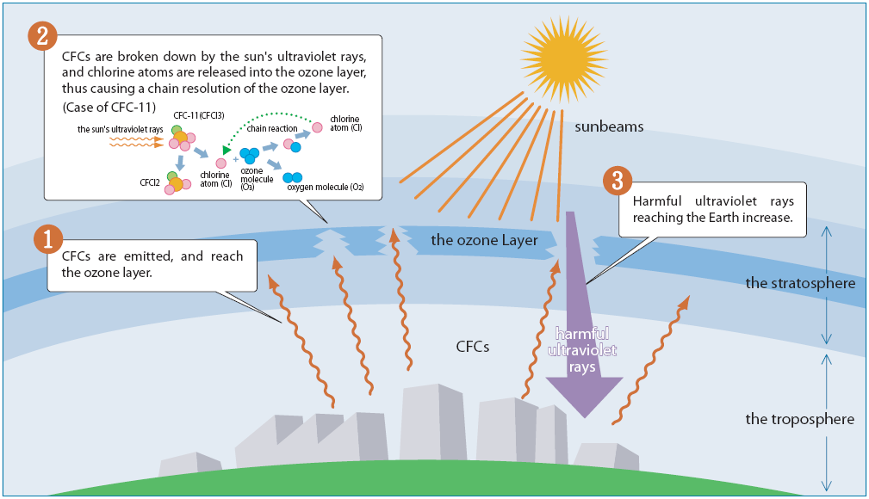

Slide 11
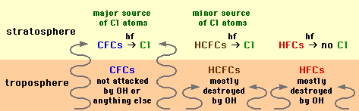
CFC Alternatives
Impact of Chlorofluorocarbon Replacements on Stratospheric Ozone
Source: http://www.mp-docker.demon.co.uk/environmental_chemistry/topic_2b/page_4.html

Slide 12
CFCs, HCFCs and HFCs

Slide 13
Thanks

